Slide 1
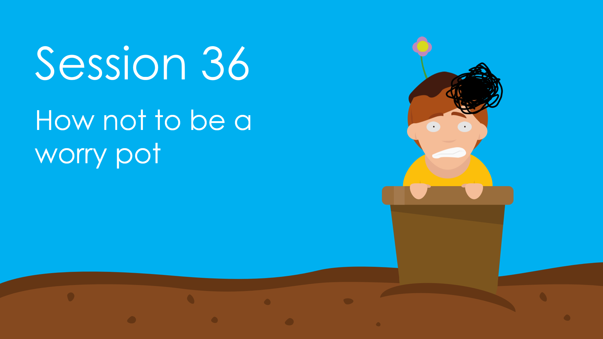
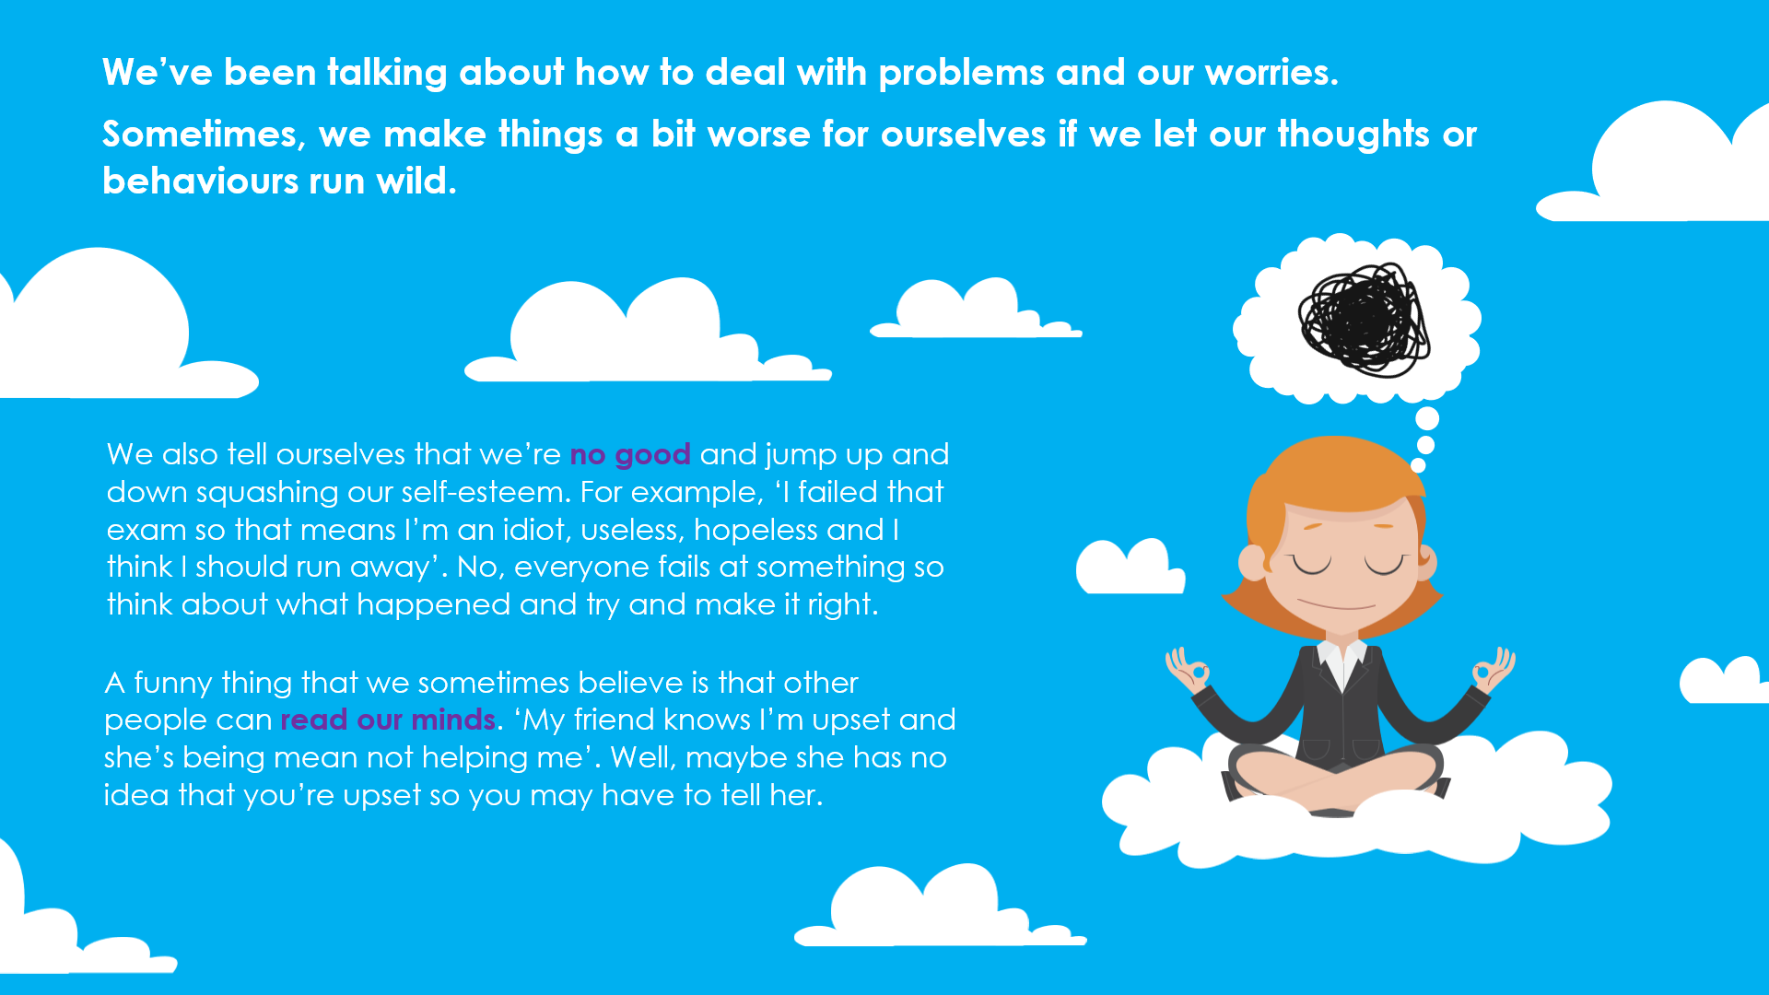
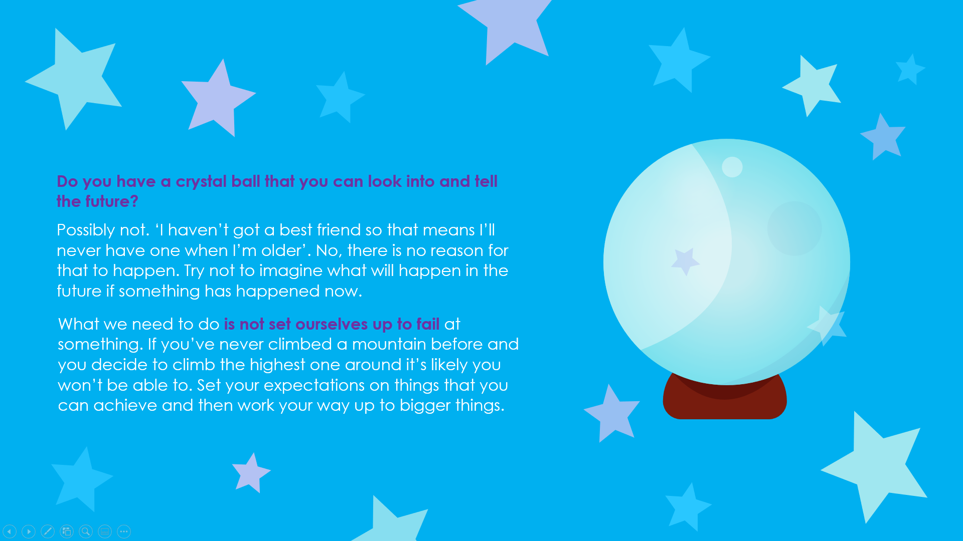
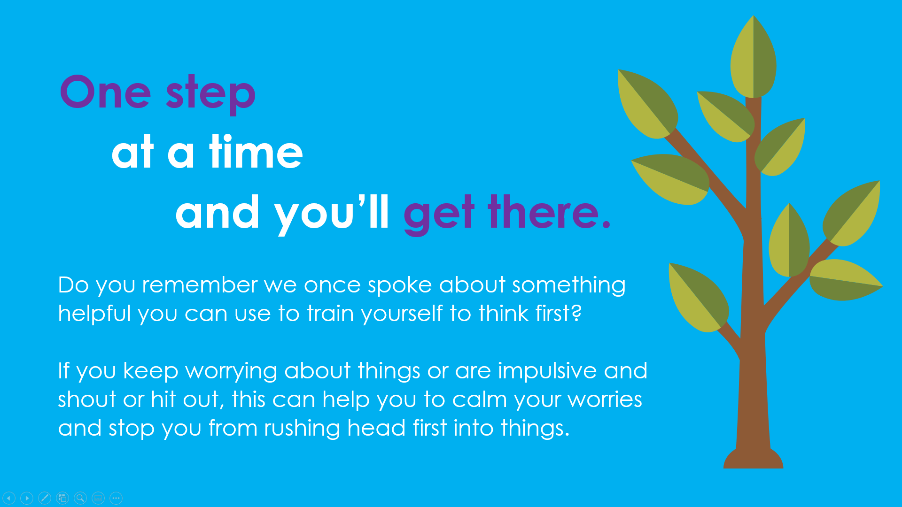
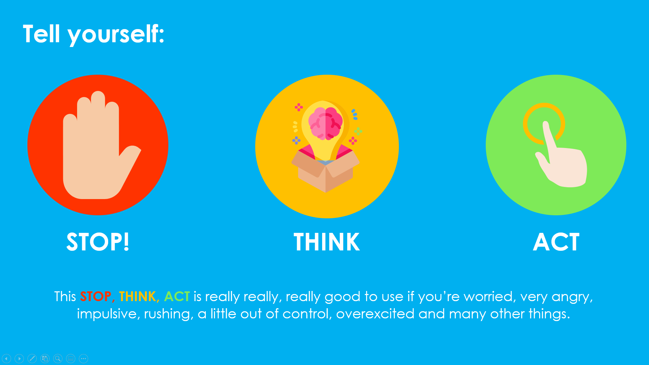
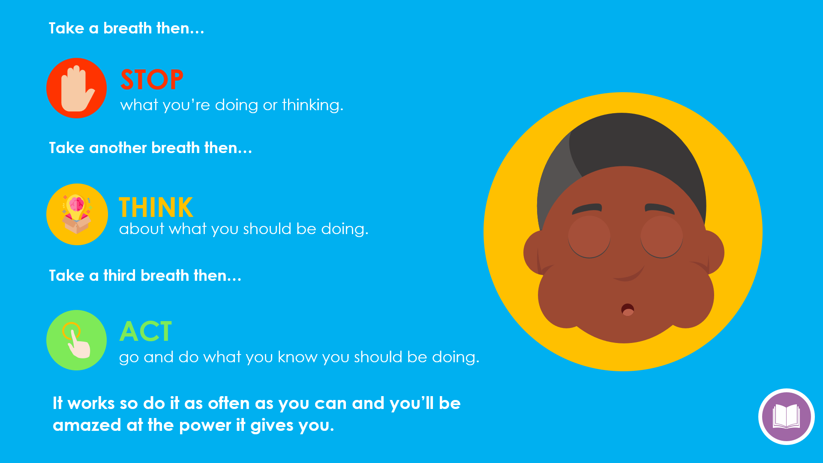
Session 36
Slides: 186 - 191
Get the children to give examples and use these in the class to show them how they can stop, think and act. Real examples will help them learn what is meant by it and roleplay scenarios which helps the concept to become integrated.
Get the children to make their own Worry Box and a traffic light of STOP THINK ACT or a chart of their liking that they can keep at home.
Equipment:
Cardboard, paper or an old box.
Craft material with colours for the traffic lights

