Slide 1
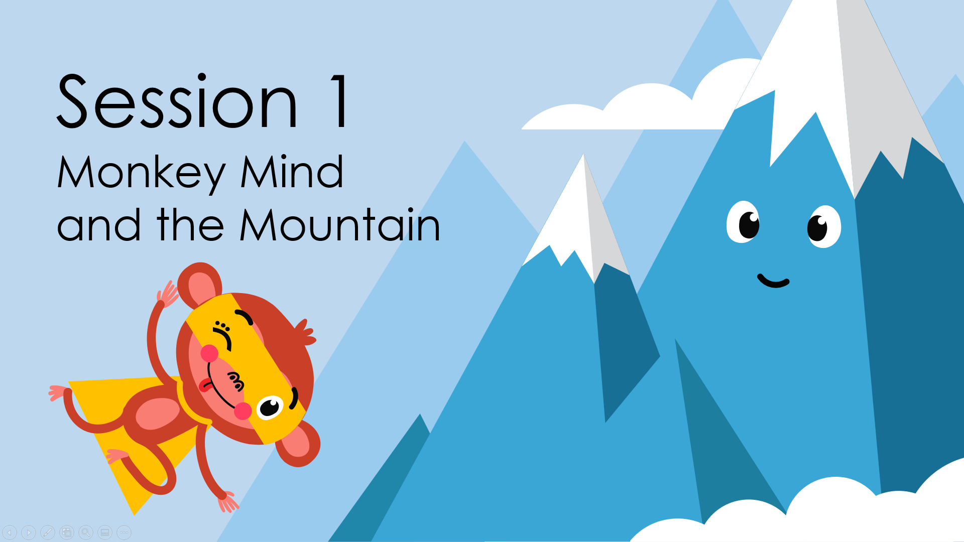
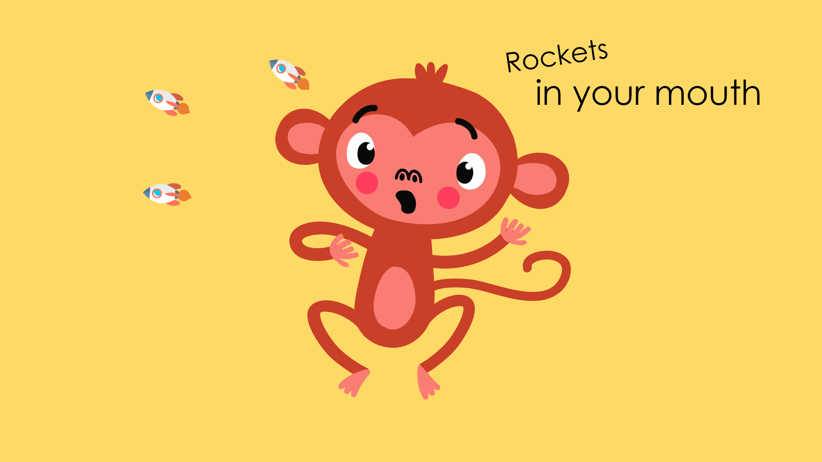
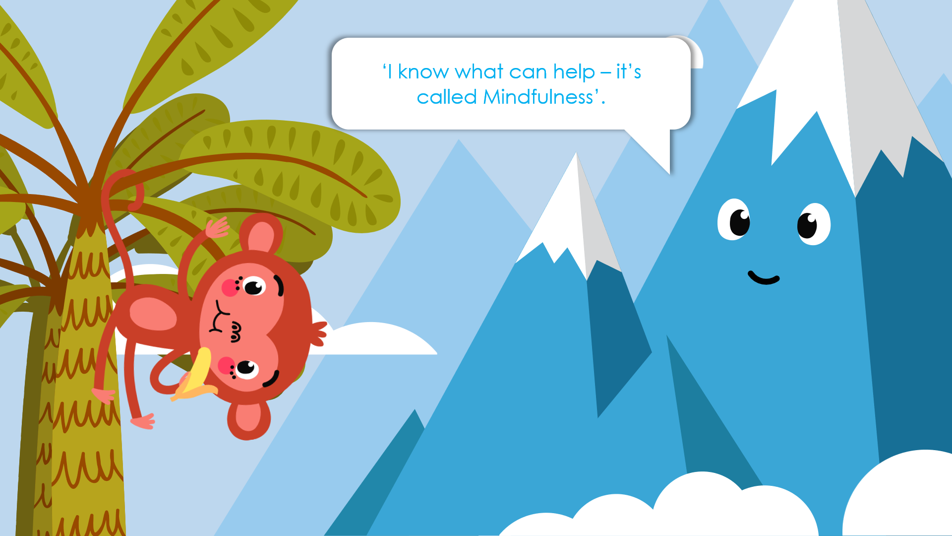
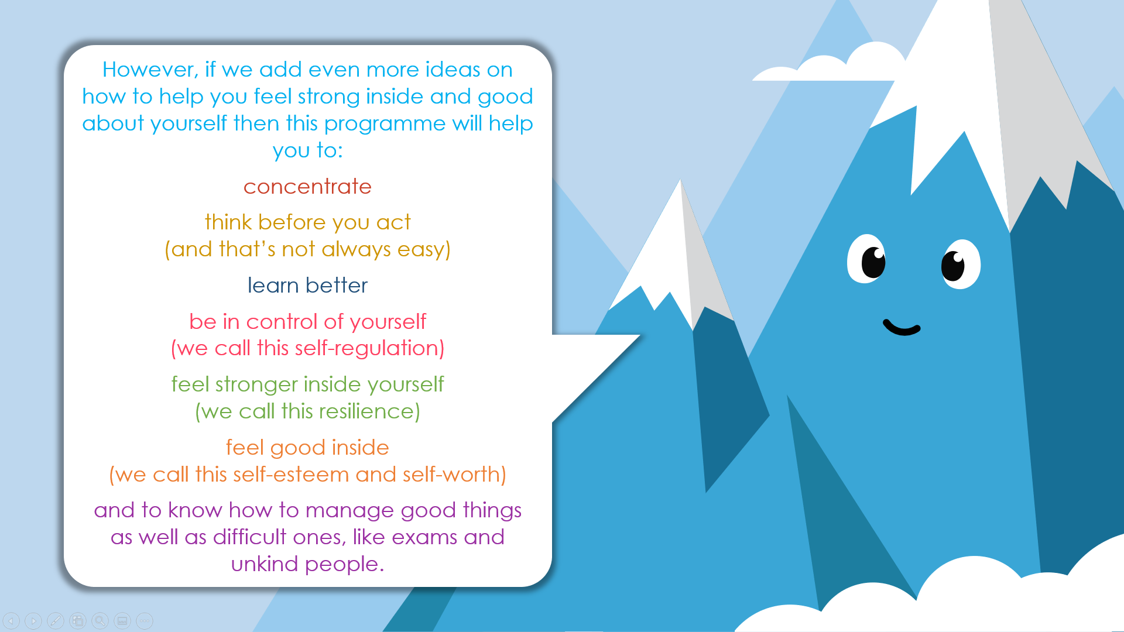
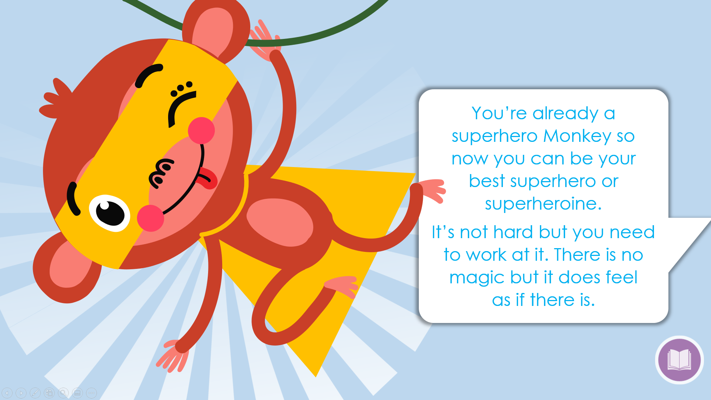
Session 1
Slides: 1 - 5
Let the children jump around like a mad monkey. Tell them to fling their arms, stamp their feet and count to 10.
Now get them to stop like a statue. Count to 10.
Let them jump around again.
Tell them to Stop.
Ask the children what it felt like when they were jumping around and what it was like when they were still.
TASK
Make an eco-friendly glitter jar.
Equipment: Glass jars with lids, biodegradable glitter, water. Glitter is no longer environmentally friendly. It is easy to source eco-friendly glitter and this helps the children to learn about looking for alternatives that don’t have a negative impact.
Let the children shake their glitter jars and then quietly watch the glitter begin to settle.
Tell the children that this is what mindfulness is like for people – we are often running, talking and doing a lot of things but we can also quieten our thoughts and actions and settle down, just like the glitter.

