Slide 1
Session 1
Monkey Mind and the Mountain

Slide 2
Rockets
When thoughts
in your head
in your mouth
Whizz around
Inside you
Springs
in your body
Feelings
in your heart

Slide 3
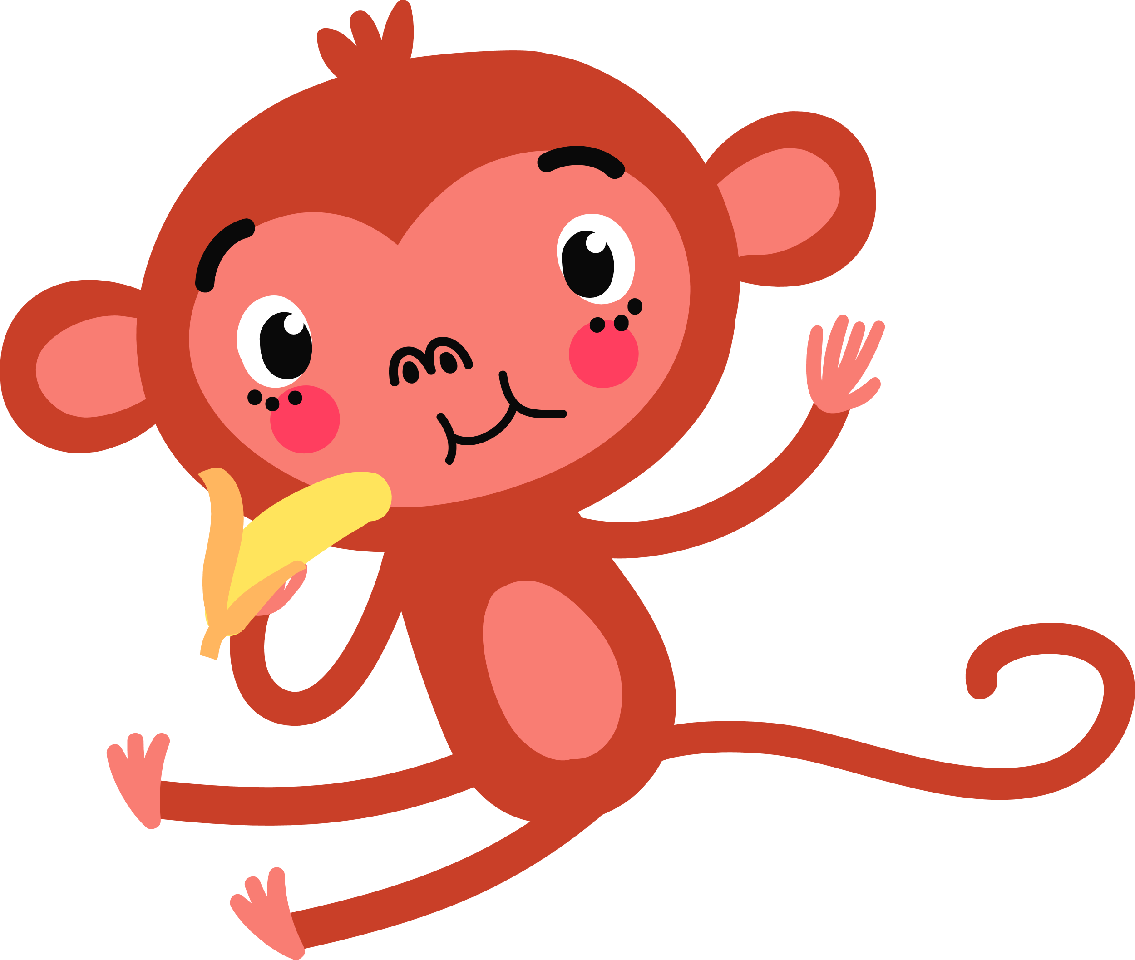
‘I know what can help – it’s called Mindfulness’.
‘Mouthful? Of what?’
It’s hard to know
‘Not mouthful. Mindfulness.’
It can help with a lot of things though I’m not sure if it can help you. We’ll have to see about that.
how to STOP them
‘What can it do? What can it do? Tell me now. Quickly.’
‘Well, perhaps the most important thing for you is that it can help you to focus and calm down.

Slide 4
However, if we add even more ideas on how to help you feel strong inside and good about yourself then this programme will help you to:
concentrate
think before you act (and that’s not always easy)
learn better
be in control of yourself (we call this self-regulation)
feel stronger inside yourself (we call this resilience)
feel good inside (we call this self-esteem and self-worth)
and to know how to manage good things as well as difficult ones, like exams and unkind people.

Slide 5
You’re already a superhero Monkey so now you can be your best superhero or superheroine.
It’s not hard but you need to work at it. There is no magic but it does feel as if there is.

